Slide 1
Contents
Introduction
Background
Project Architecture
Functional Verification
Synthesis Flow
Simulation, Analysis Results & Comparison Table
Preferred Architecture
Physical Design Plan
Design Challenges
Future Work
Conclusion
References

Slide 2
Introduction
Objective of the Project
Design and implement three clock divider architectures:
DFF-based
Gated LFSR-based
8T SRAM-based
Integrated clock gating, power gating and test mode into each design.
Verified functionality via simulation in ModelSim.
Performed synthesis and compare area, power, and timing using Synopsys Design Compiler.
Identified the most efficient design for physical implementation using Cadence Innovus.
Motivation
Clock dividers are essential for generating slower clock signals in processors like RISC-V.
Traditional D flip-flop (DFF) based dividers cause high switching activity and increased dynamic power.
There is a need for low-power, efficient clock chain dividers using gating techniques and alternative logic structures.

Slide 3
Background
In synchronous digital systems, clock chain dividers are used to generate lower-frequency clocks from a single high-speed source.
These are widely applied in processors (like RISC-V) for managing different clock domains, enabling peripheral interfaces, and controlling power-managed blocks.
D flip-flop (DFF) chains are the conventional method for implementing dividers due to their simplicity and predictability.
However, they are not power-efficient, especially when always active, leading to continuous switching and increased dynamic power consumption.
To address this, the project explores alternative architectures that reduce switching activity and leakage using clock gating, power gating, and novel logic like gated LFSRs and symbolic 8T SRAM-based storage.

Slide 4
Architecture Overview - Part1
Clock Divider Architectures – DFF & Gated LFSR
Three clock divider architectures were designed with clock gating, power gating, and test mode for low-power operation.
1. DFF-Based Divider
Uses a chain of D flip-flops to shift a toggling bit.
Simple structure but high switching activity.
Used as the baseline for comparison.
2. Gated LFSR-Based Divider
8T SRAM-based
Implements an LFSR with XOR feedback for pseudo-random shifting.
Integrates clock and power gating to reduce unnecessary toggling.
Offers better power efficiency than DFF-based design.

Slide 5
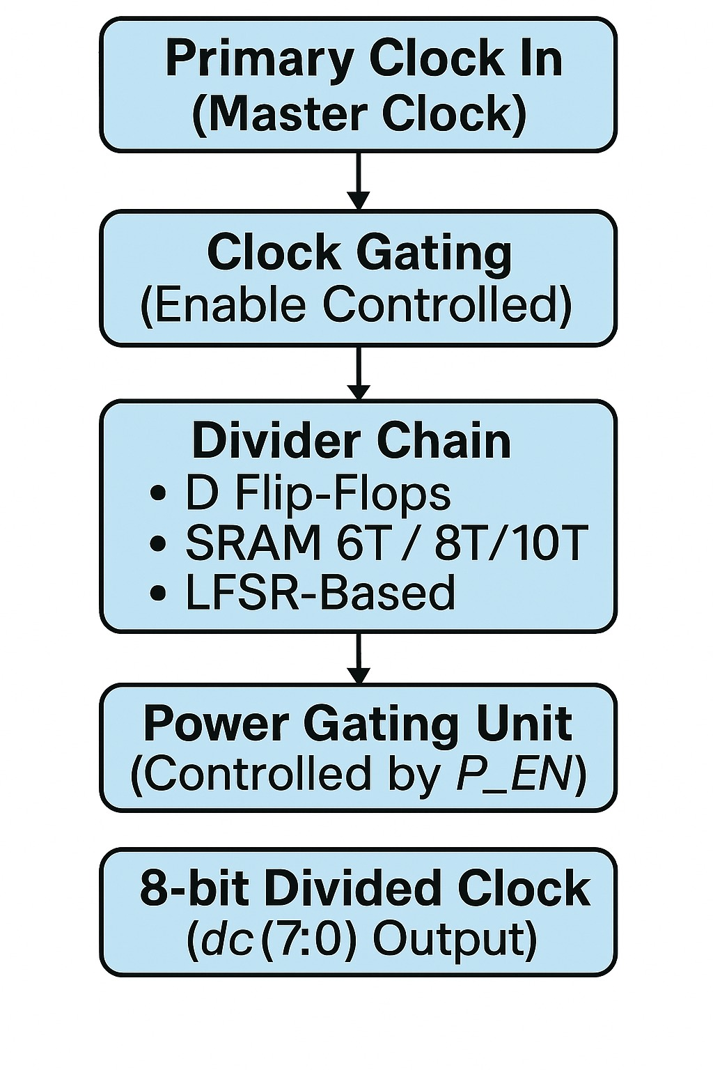
Architecture Overview -Part2
Clock Divider Architecture – 8T SRAM-Based
3. 8T SRAM-Based Divider
Built using symbolic 8T SRAM bitcells in a shift-chain arrangement.
Activates one cell at a time using WWL and RWL signals.
Naturally supports state retention and fine-grained gating.
Demonstrated the best trade-off in area, power, and timing.
Common Features Across Designs
Clock Gating: Disables clock when idle.
Power Gating: Holds state and reduces leakage.
Test Mode: Overrides gating for simulation and debug.
Figure 1: Core Architecture

Slide 6
Functional Verification (ModelSim)
All three designs were verified using ModelSim to ensure correct behavior before synthesis.
Testbenches were created to simulate:
Clock and reset behavior
Output transitions
Clock gating, power gating, and test mode functionality
Waveform analysis confirmed:
Correct toggling/shift operations
Output holding during clock/power gating
Gating overridden successfully in test mode
Verification ensured all designs were functionally correct and ready for synthesis.

Slide 7
Synthesis Flow (Design Compiler)
All three designs were verified using ModelSim to ensure correct behavior before synthesis.
Steps Followed:
Created individual folders for each design in Documents Folders (DFF, Gated LFSR, SRAM-based).
Copied Verilog source files into each folder.
Modified the .vfs and .vfv setup files to point to the correct top module and file paths.
Used the synth command to run synthesis and generate: Gate-level netlist (.vg), Area, Power, and Timing reports

Slide 8
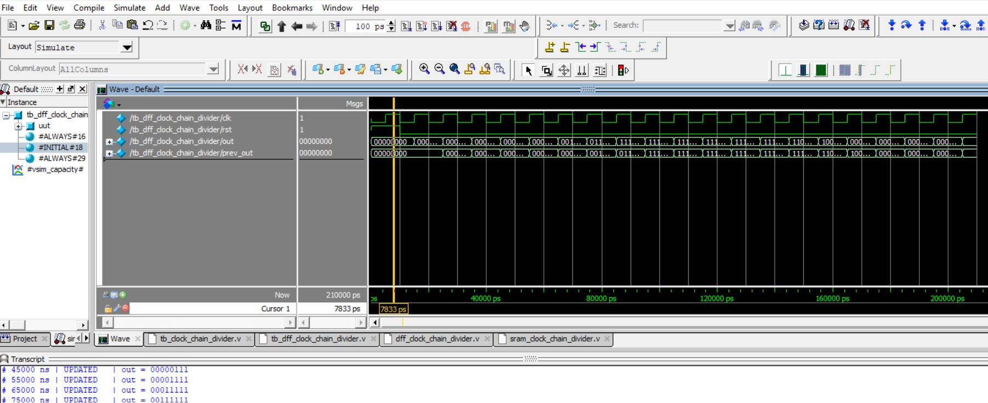
DFF Modelsim Waveforms
Figure 2: Clock gated and Power gated DFF Chain Divider Modelsim waveforms

Slide 9
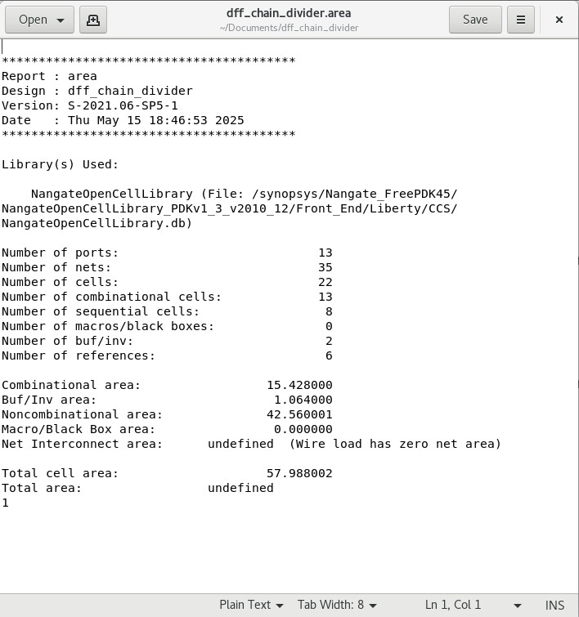
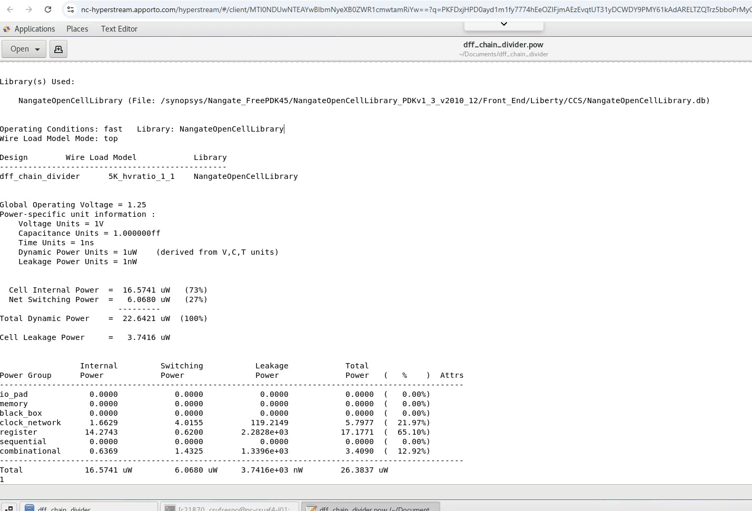
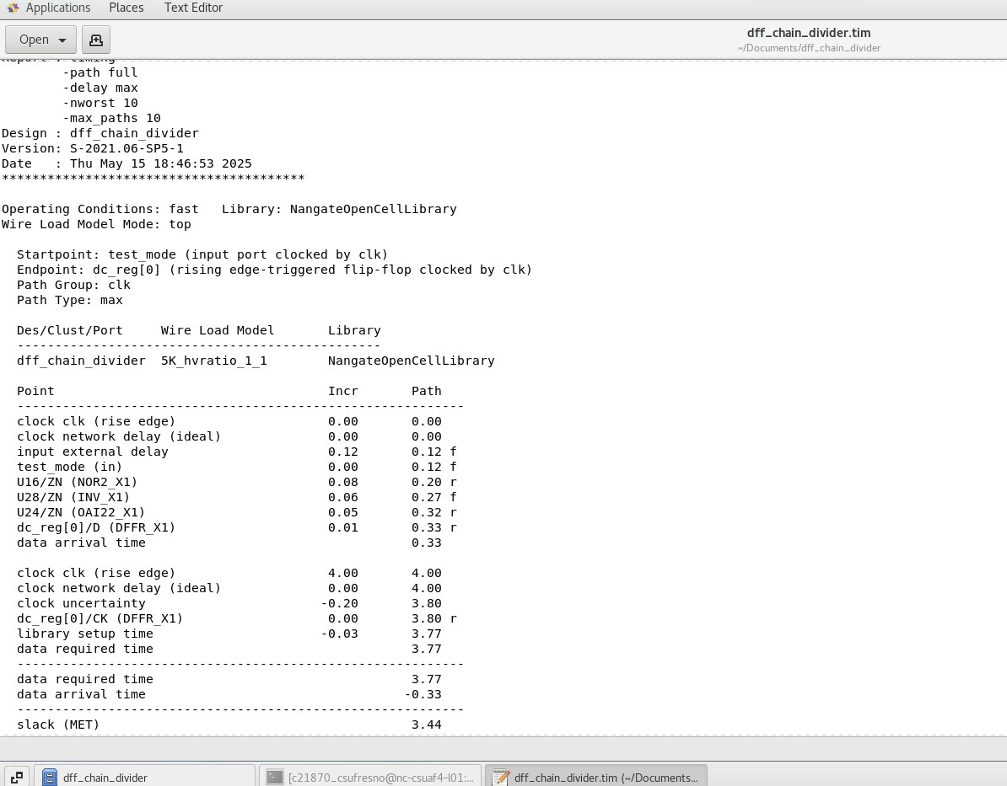
DFF Synopsys Analysis Reports
Figure 3: Snippets of area, power and Timing Reports for Chain Divider DFF using clock and power gating

Slide 10
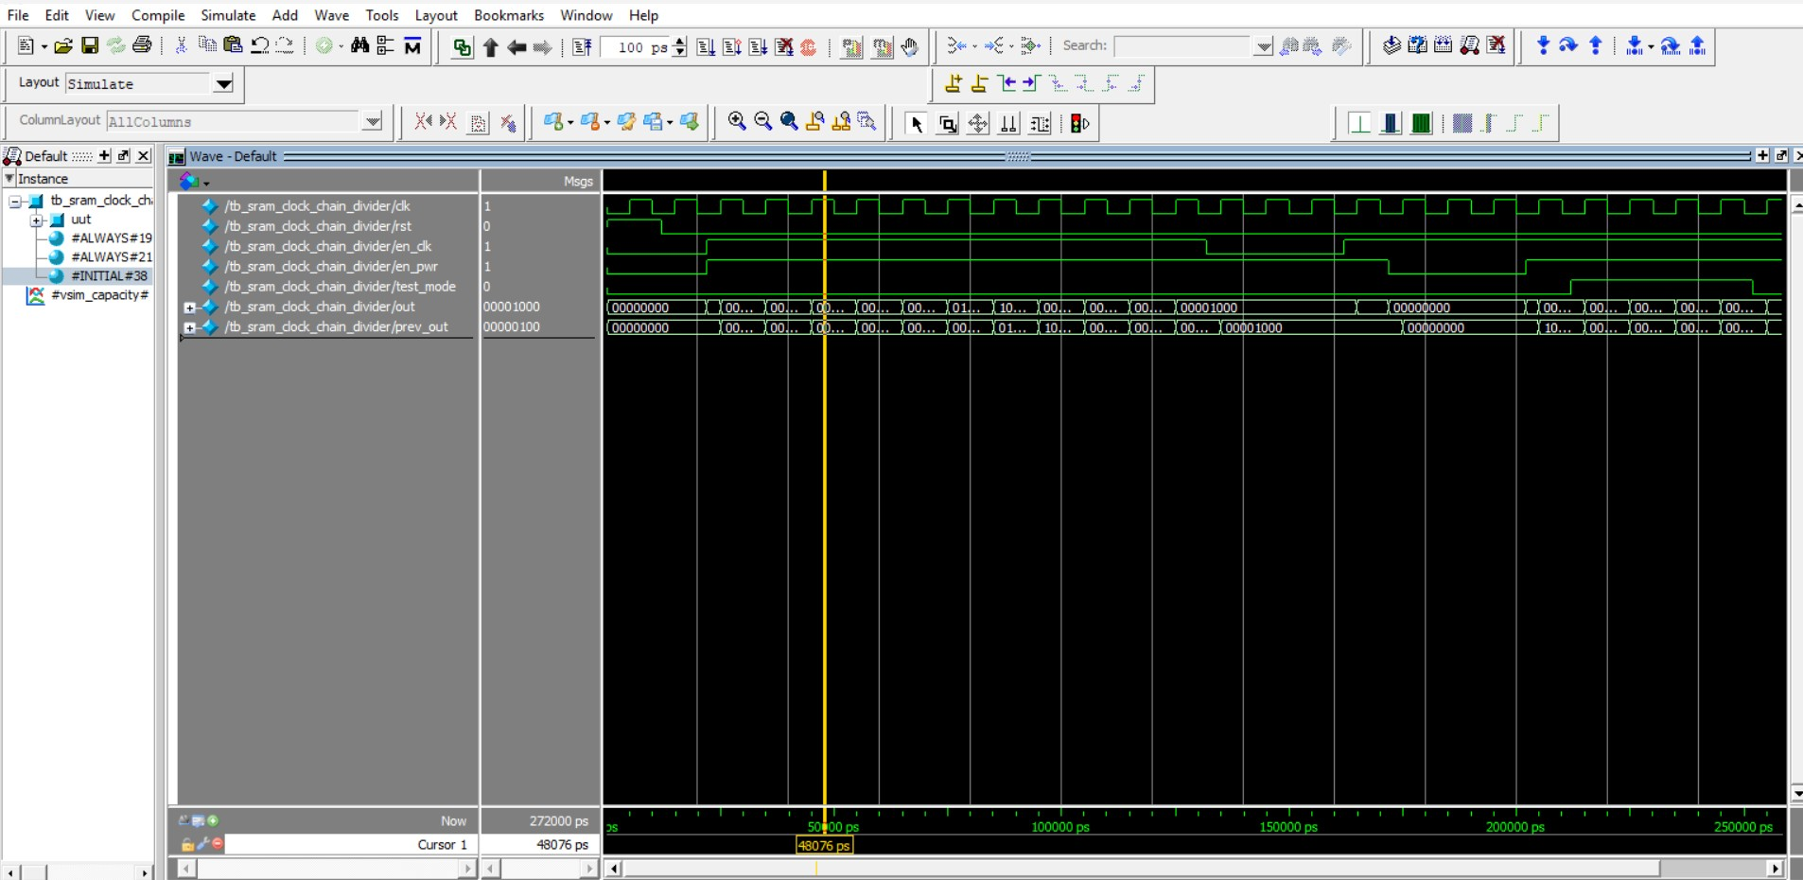
8T SRAM Modelsim Waveforms
Figure 4: Clock gated and Power gated 8T SRAM Chain Divider Modelsim waveforms

Slide 11
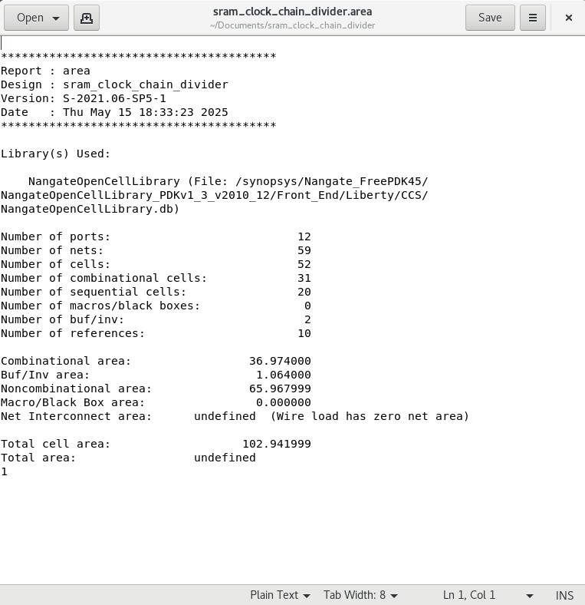
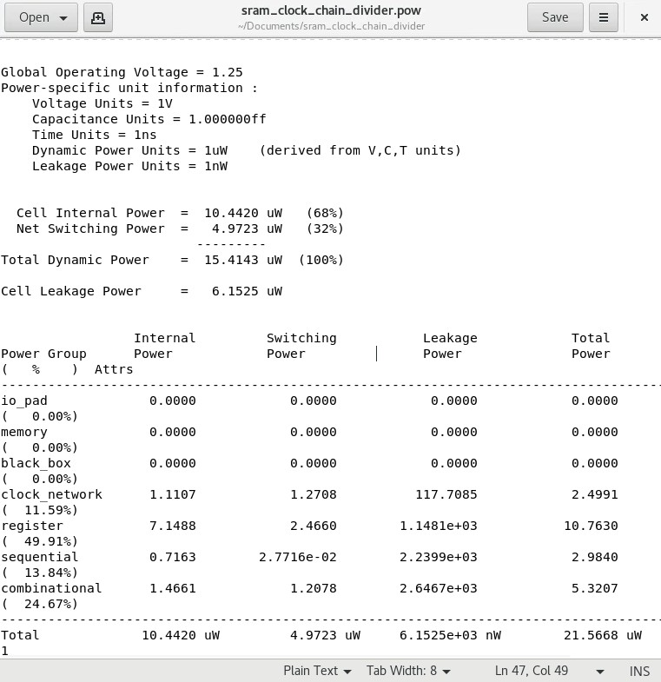
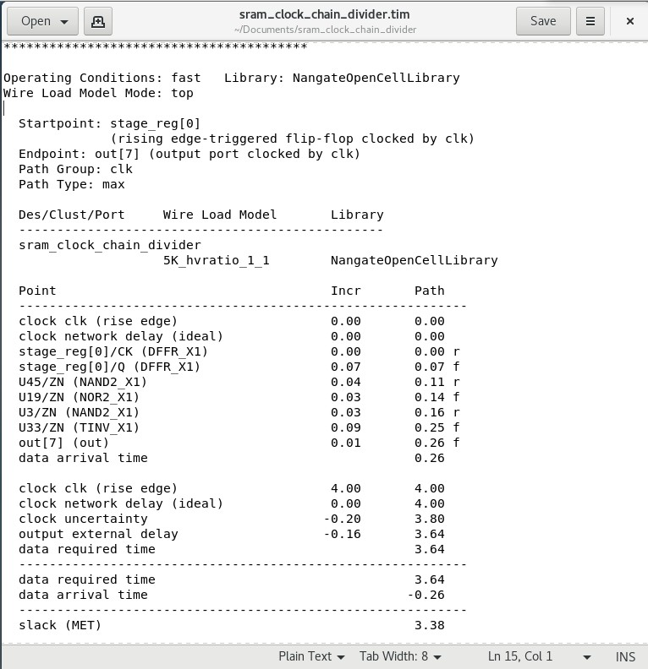
8T SRAM Synopsys Analysis Reports
Figure 5: Snippets of area, power and Timing Reports for Chain Divider 8T SRAM using clock and power gating

Slide 12
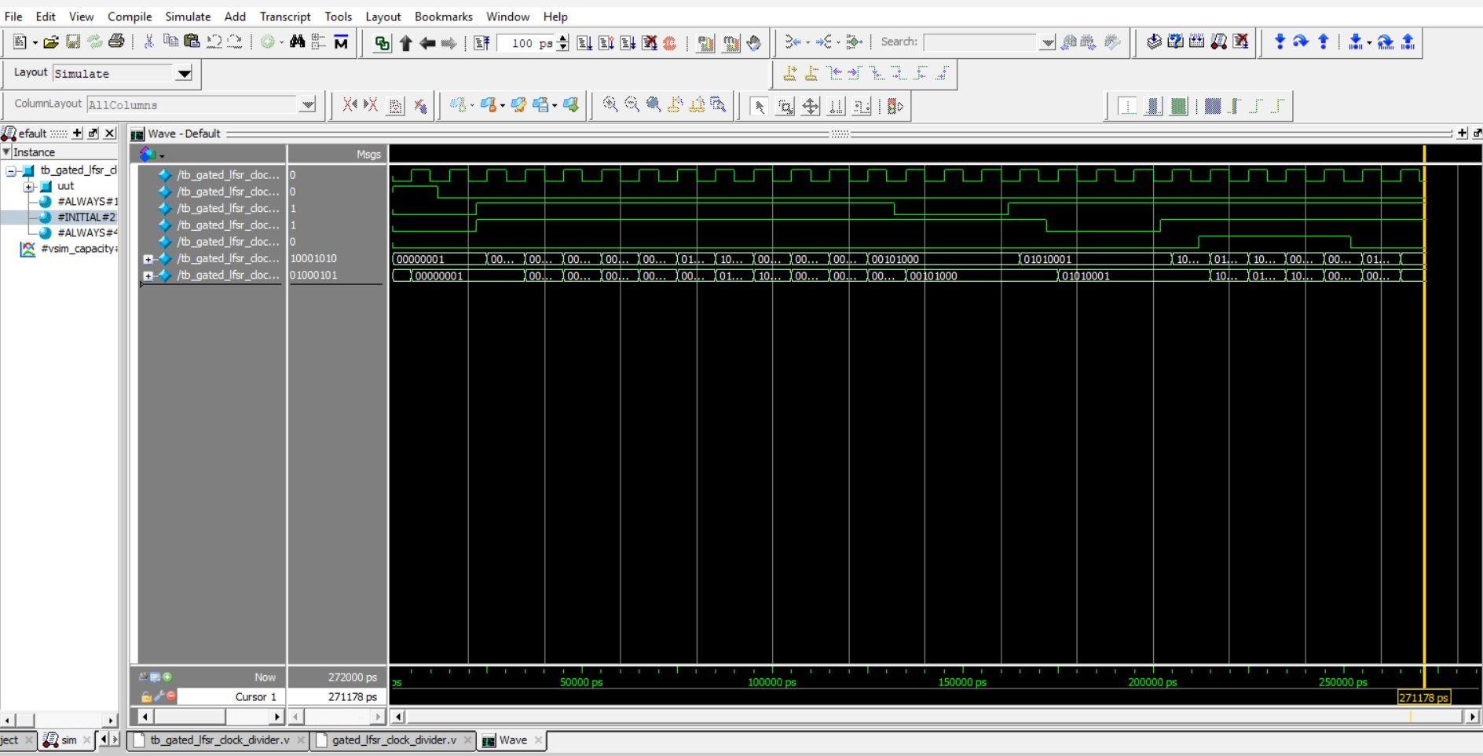
LFSR Modelsim waveforms
Figure 6: Clock gated and Power gated LFSR Chain Divider Modelsim waveforms

Slide 13
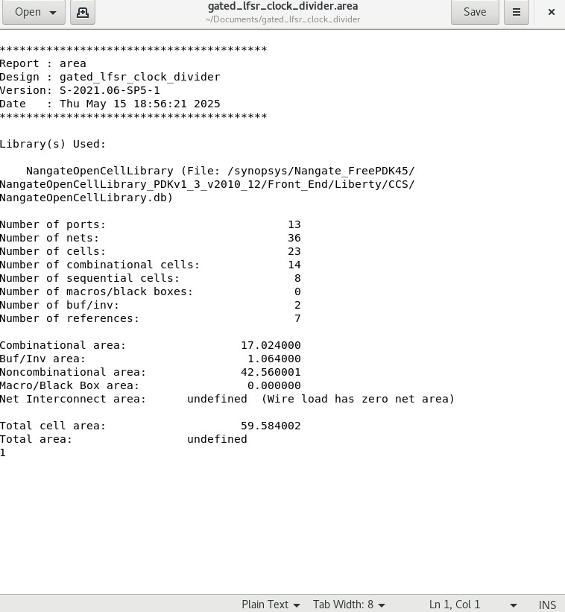
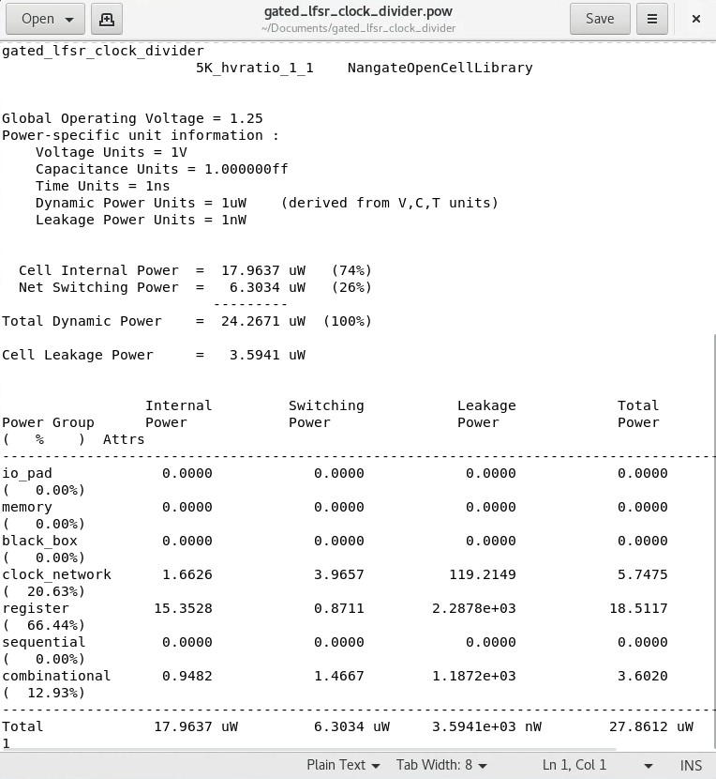
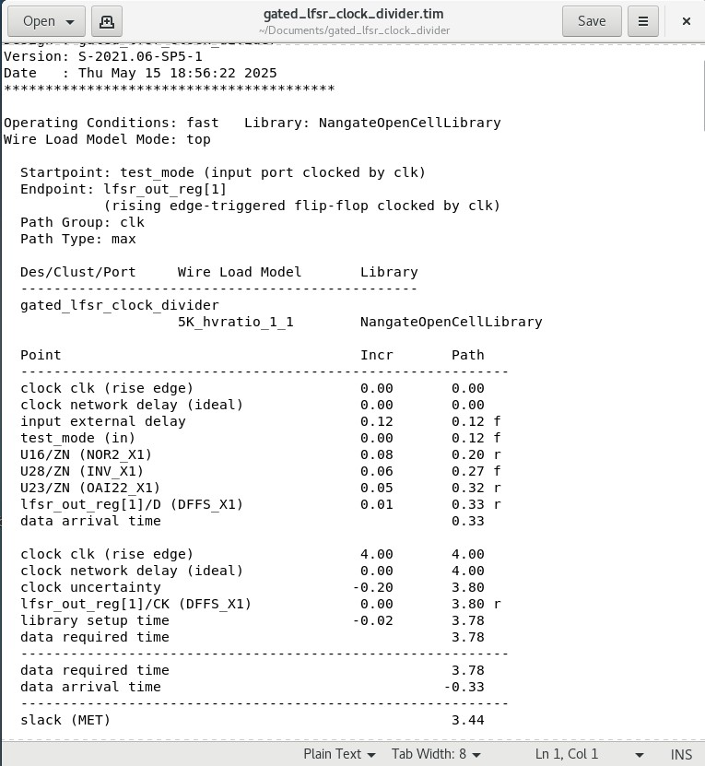
LFSR Synopsys Analysis Reports
Figure 7: Snippets of area, power and Timing Reports for Chain Divider LFSR using clock and power gating

Slide 14
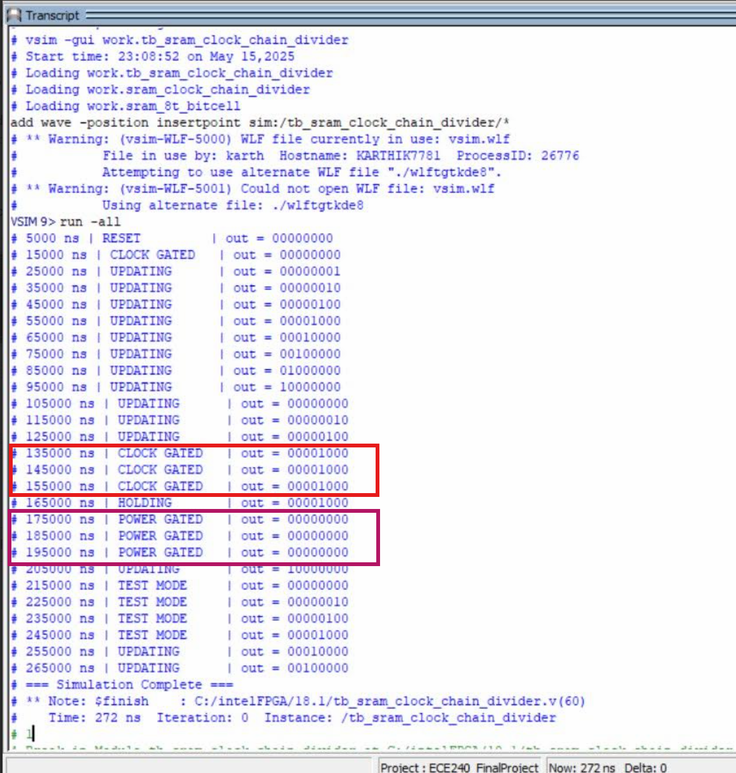
SRAM- Gating Functionality Verification
This verifies the effectiveness of gating logic in preserving output without unnecessary switching.
Figure 8: ModelSim simulation transcript showing correct output retention during Clock Gating and Power Gating for the SRAM-based clock divider.

Slide 15
Comparison Table
Sno. | Metric | DFF-Based Divider | Gated LFSR Divider | 8T SRAM-Based Divider
1 | Total Cell Area (µm²) | 57.99 | 59.58 | 102.94
2 | Combinational Area (µm²) | 15.43 | 17.02 | 36.97
3 | Sequential Cells | 8 | 8 | 20
4 | Total Dynamic Power (µW) | 20.63 | 24.27 | 15.41
5 | Total Power (µW) | 26.38 | 27.86 | 21.57
6 | Worst Case Slack (ns) | 3.44 | 3.44 | 3.38
Figure 9: Comparison of DFF, 8T and Gated LFSR based clock-divider
The 8T SRAM-based divider offers the lowest power consumption with acceptable timing, despite a larger area. It provides the best overall trade-off for energy-efficient clock division compared to DFF and LFSR designs.

Slide 16
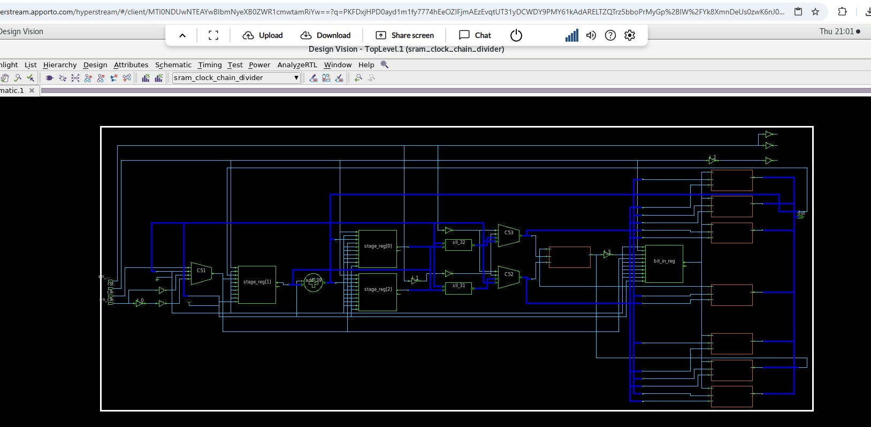
Preferred Architecture
The 8T SRAM-based divider was selected for its superior power efficiency and compatibility with clock/power gating.
Its memory-like behavior supports state retention and minimized switching, making it ideal for power-sensitive applications.
Figure 10: RTL view of SRAM-based clock divider

Slide 17
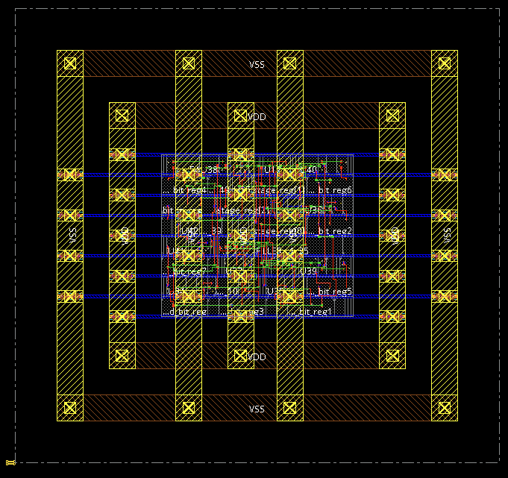
Physical Design Plan (Cadence Innovus)
The selected SRAM-based divider is planned for physical implementation in Cadence Innovus.
Backend design flow includes:
Floorplanning
Power planning (power rings and stripes)
Placement of standard cells
Special routing and NanoRoute for detailed connections
Power analysis to ensure low-power operation
Design setup prepared using synthesized netlist and constraint files.
Post-route static timing analysis (STA) is identified as the next step.
Figure 11: Screenshot of physical design setup from Innovus.

Slide 18
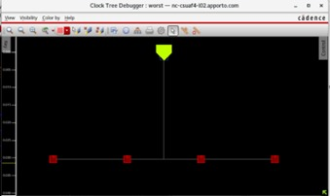
Clock Tree Synthesis
Figure 12: Clock tree synthesis
We used Cadence Innovus to perform CTS for the SRAM-based clock chain divider. The commands shown were executed in the terminal to define buffer cells, create the tree specification and optimize the design using the ccopt_design command.
However, the Clock Tree Debugger showed a minimal structure, suggesting that either the buffers were not inserted, or CTS was not fully executed. This will be addressed in the post-CTS optimization stage as part of future work.
The Clock Tree Debugger in Cadence Innovus shows direct routing from a single clock source to four sinks without intermediate buffers. This flat structure results from the small design size and lack of compatible buffer cells. Despite no buffer insertion, minimal skew and valid timing are maintained.

Slide 19
Design Challenges
Designing symbolic 8T SRAM logic to mimic sequential behavior.
Implementing clean clock and power gating logic across all architectures.
Managing waveform analysis and synthesis comparison accurately.
Preparing clean netlists and constraints for physical design tools.

Slide 20
Future Work
Complete post-route static timing analysis in Innovus.
Perform power integrity and signal integrity checks.
Explore scaling of SRAM-based divider to 16-bit or 32-bit chains.
Integrate the divider into a RISC-V subsystem as a functional module.

Slide 21
Conclusion
Successfully designed and implemented three clock divider architectures:
DFF-based, Gated LFSR, and 8T SRAM-based.
Integrated clock gating, power gating, and test mode across all designs for low-power control.
Verified functional correctness using ModelSim and synthesized all designs using Synopsys Design Compiler.
Compared area, power, and timing metrics. The SRAM-based divider was found to be the most efficient.
RTL schematic validated using Design Vision and physical design flow planned in Cadence Innovus.
The project demonstrates the effectiveness of SRAM-based logic with gating strategies in building scalable, power-aware digital systems.

Slide 22
References
[1] https://www.efinixinc.com/products-riscv-en.html
[2] https://www.researchgate.net/figure/The-schematic-diagram- of-8T-SRAM-cell_fig3_283862501
[3] Ahmed, S., et al. “Clock Division and Randomization using LFSRs for Power Optimization,” IEEE Access, vol. 8, pp. 204799–204808, 2020.
[4] Weste, Neil H.E., and David Harris. CMOS VLSI Design: A Circuits and Systems Perspective. Pearson.
[5] Synopsys Design Compiler User Guide, Synopsys Inc.
[6] Cadence Innovus Implementation System User Guide, Cadence Design Systems.
[7] ModelSim User Manual, Mentor Graphics.
[8] Synopsys Design Vision Documentation, Synopsys Inc.

